Slide 1
p53 mutation sensitizes PDAC to immunotherapy by eliciting Interferon response
May 15th, 2019 September 15th, 2021
Sharp Lab / Jain Lab
Notes:
Antiviral type-I Interferon response

Slide 2
Presentation Outline
Problem
Experimental Setup
Analysis Pipeline
Findings
Future Research

Slide 3
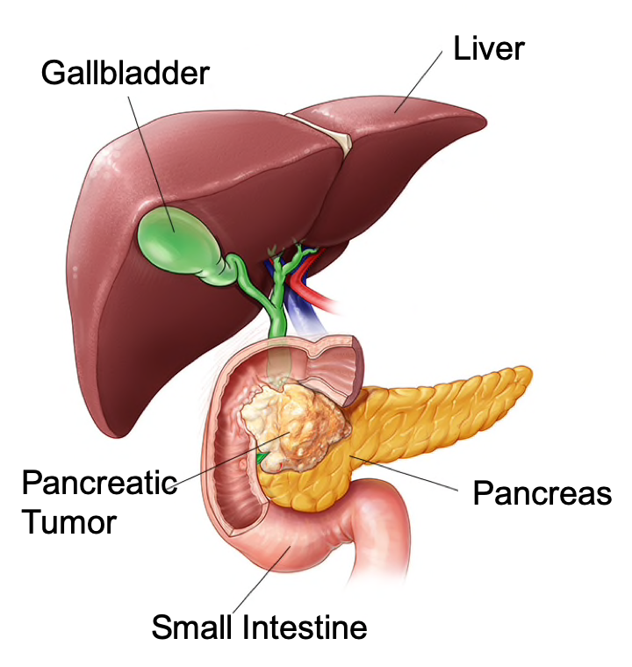
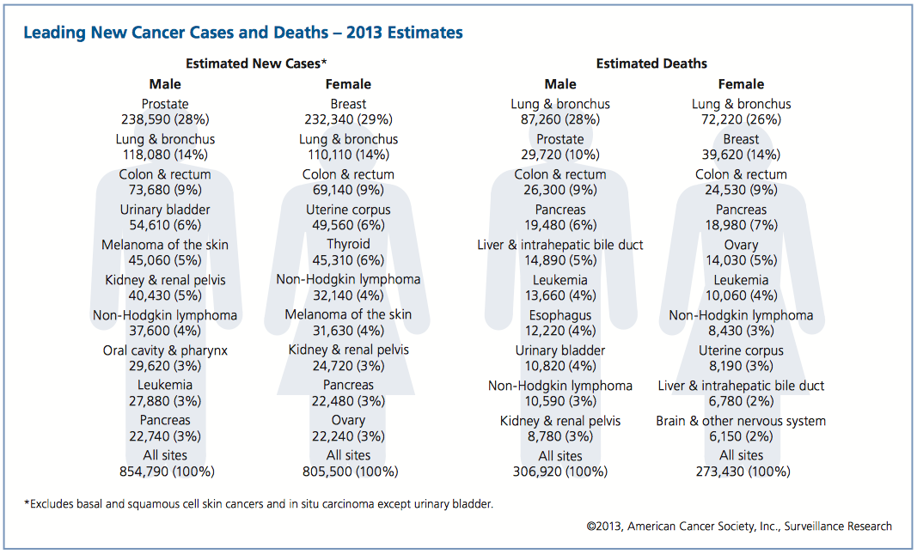
Pancreatic Ductal Adenocarcinoma (PDAC)
Mayoclinic.org
http://www.cancer.org/acs/groups/content/@epidemiologysurveilance/documents/document/acspc-036845.pdf
Highly lethal malignancy --- third leading cause of cancer-related deaths
~ 50,000 people will die of PDAC in 2021
~ 80% of patients present with locally advanced or metastatic disease
Considered incurable: 5-year survival < 11%
Current treatment options are largely ineffective

Slide 4
Immune checkpoint inhibitors (ICIs) to unleash antitumor immunity
Survival rates of melanoma patients by type of treatment
AACR 2016; J Clinical Oncology
Survival (%)
Years after diagnosis

Slide 5
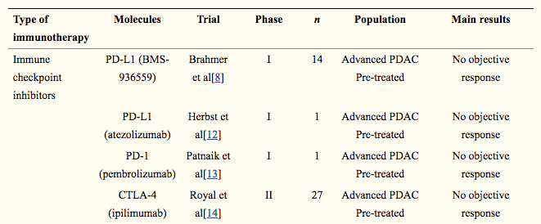
Immunotherapy is largely ineffective in PDAC
Summary of clinical trials of immune therapies in PDAC patients
Hilmi M, Bartholin L, Neuzillet C. World J Gastroenterol. 2018;24(20):2137-2151.
Inefficacy is primarily due to low immunogenicity and non-inflamed phenotype of PDAC
PDAC stroma generates a hypoxic microenvironment
Immunosuppressive microenvironment is established through CAFs and TGFβ secretion
Several strategies to overcome immunosuppressive microenvironment:
Combinatorial ICI to increase tumor immunogenicity
Recruitment and activation of effector T cells
Notes:
CXCL9, -10, and -11 are mainly secreted by monocytes, endothelial cells, fibroblasts, and cancer cells in response to IFN-γ. The work of CXCL9, -10, -11/CXCR3 axis is mainly divided into two directions; paracrine signaling for immune activation and autocrine signaling for proliferation and metastasis of cancer cells. As for paracrine signal, this axis works primarily for immune cell migration, differentiation, and activation. Immune reactivity is occurred with recruitment of CTLs, NK cells, NKT cells, and macrophages through this axis, and Th1 polarization by this axis also activate the immune cells in response to IFN-γ. On the contrary, as for autocrine signal, cancer cells have a propensity to metastasize due to the tumor-derived ligands activity mainly through CXCR3A. Tumor-derived chemokines are also responsible for recruitment of Th2 cells, Tregs, and MDSCs, which play the role of creating a pro-tumoral microenvironment. Abbreviations: CTLs, cytotoxic lymphocytes; NK, natural killer; NKT, natural killer T; MΦ, macrophage; MDSCs, myeloid derived suppressor cells; Th0, naive T; Th1, T helper 1; Th2, T helper 2; Th17, T helper 17; Tregs, regulatory T cell

Slide 6
Presentation Outline
Problem
Experimental Setup
Analysis Pipeline
Findings
Future Research

Slide 7
Transcriptional signatures to immunotherapy in PDAC
Pre-clinical model of PDAC
Biomarkers of immunotherapy response
Molecular mechanism(s) of immunotherapy response
Corroborate with patient data
Validate with clinical model of PDAC & patient samples

Slide 8
Selective response of pre-clinical models of PDACs to immune checkpoint inhibitors (ICIs)
KPC001s
PAN02
AK4.4
HY19636
Kras^{G12D/+} / Trp53^{R172H /+}
Smad4^{m174} / Trp53^{+/+}
Kras^{G12D/+} / Trp53^{-/+}
Kras^{G12D/+} / Trp53^{-/+}
*
*
n.s.
n.s.
Percent survival
Days after implantation
--- Control --- a-PD-1 + a-CTLA4

Slide 9
Focus on KPC and HY due to model availability
KPC–p53-GOF
HY—p53-Del
Kras^{G12D/+} / Trp53^{R172H /+}
Kras^{G12D/+} / Trp53^{-/+}
*
n.s.
Percent survival
Days after implantation
--- Control --- a-PD-1 + a-CTLA4

Slide 10

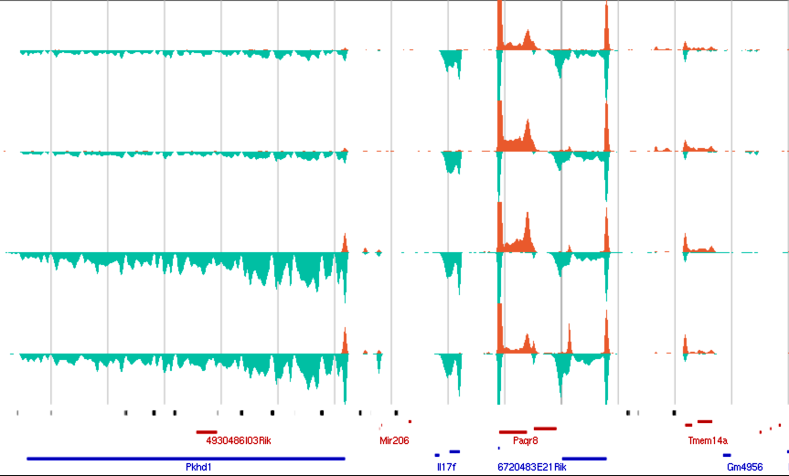

Data Collection
KPC001S: (responsive to ICIs)
HY19636: (non-responsive to ICIs)
in-vivo
transcriptional changes in tumor microenvironment after ICIs
Orthotopic tumor
implantation
Immunotherapy
IgG OR ICIs
3X every 3 days
Tumor extraction
PROseq library preparation & sequencing
Notes:
Hypothesis of the project: Tumor stroma in PDAC creates barriers to penetration of therapeutics and infiltration of cytotoxic lymphocytes. Targeting the stromal barriers will alleviate immunosuppression and potentiate immune checkpoint blockades.
How does tumor microenvironment (TME) influence cancer cells-stoma cell interactions before and after treatment of immunotherapy?
Why are there different therapeutic responses from the the two cell lines (responder vs. non responder)? Does TME contribute to the differences?
What are the cell types/cellular components that are important in modulating the response to immunotherapy?
The one difference between the cell lines is the status of TP53 gene. HY19636 is TP53-deleted while KPC0001s is TP53-mutated. Could the status of TP53 play an important role in determine whether the mice respond to immunotherapy? What exactly are their TP53 status (we can learn from it using the ePROseq analysis?)?

Slide 11
What is PRO-seq?
Comprehensive transcriptomics through nascent transcription
Pol II
3’ = active site
RNA
5’ cap
Biotin-NTP
RNA adaptors
Run-on with biotinylated NTPs → ~1bp
RNA fragmentation & affinity purification (3X)
Adapter ligation, RT and PCR
High throughput sequencing & 3’ end mapping
Features of PRO-seq:
Comprehensive snap-shot of active transcription
Unaffected by background levels of accumulated RNA
High sensitivity, base-pair resolution, strand specific
Kwak et al. (2013) Science 339:950
Mahat et al. (2016) Nature Protocols. 11 (8)
Also method pioneered by my postdoc 3 years previously…

Slide 12
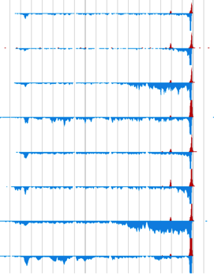
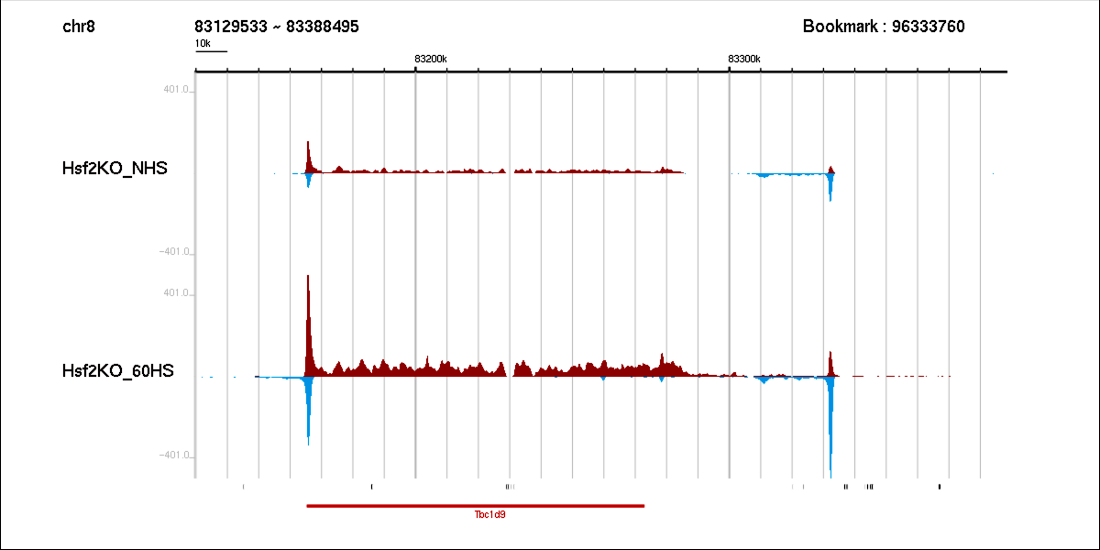
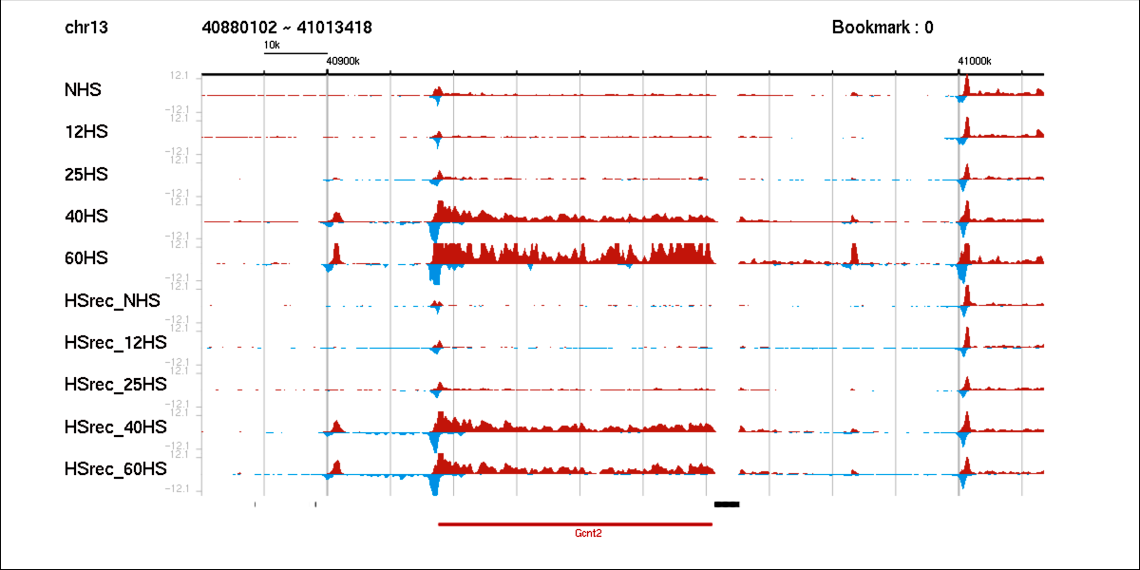
PRO-seq Advantages
High temporal resolution shows activity of regulatory elements
10kb
37⁰C
2.5 min at 42⁰C
12 min at 42⁰C
60 min at 42⁰C
Control
10 kb
37⁰C
Treatment
12 min at 42⁰C
25 min at 42⁰C
40 min at 42⁰C
60 min at 42⁰C
Notes:
Contrast with RNA-seq

Slide 13
Experimental Setup
Compare treated vs untreated to find response mechanisms
Untreated
IgG
Treated
ICI
3 Replicates
3 Replicates
KPC
p53 Gain of Function
HY
p53 Deletion
3 Replicates
3 Replicates

Slide 14
Experimental Setup
Compare cell types to find response
Untreated
IgG
Treated
ICI
3 Replicates
3 Replicates
KPC
p53 Gain of Function
HY
p53 Deletion
3 Replicates
3 Replicates

Slide 15
Presentation Outline
Problem
Experimental Setup
Analysis Pipeline
Findings
Future Research

Slide 16
Analysis Pipeline
PROseq *.fastq
Genome Alignment
Transcript Raw counts
preprocessing
Notes:
Alignment done with bowtie+SAMtools+bigwig-storage
DEseq2 normalized with both estimateSizeFactors and single-aligned reads per millions…estimate seemed better

Slide 17
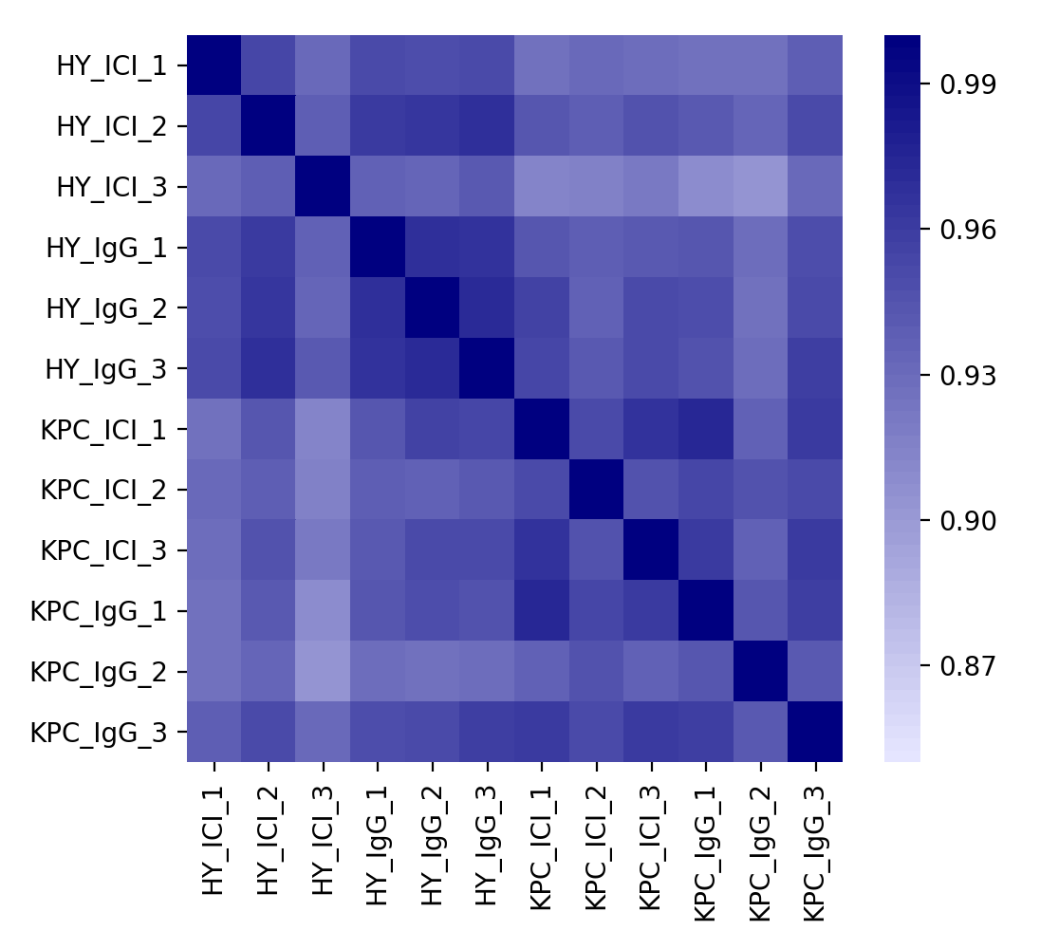
PROseq biological replicates correlate along cell type
Normalized Expression
Pearson Correlation

Slide 18
PROseq biological replicates correlate along cell type
Normalized Expression
Pearson Correlation
Do not correlate along treatment condition

Slide 19
Analysis Pipeline
PROseq *.fastq
Genome Alignment
Transcript Raw counts
DEseq2 Normalization
preprocessing
Differential Statistics
Notes:
Alignment done with bowtie+SAMtools+bigwig-storage
DEseq2 normalized with both estimateSizeFactors and single-aligned reads per millions…estimate seemed better

Slide 20
DEseq2 Overview
Strives to detect differentially expressed genes from count data
Research standard for RNA based analysis
Normalizes log2(Fold Change) with a negative binomial distribution
Can accommodate multiple replicates
Gene ID | Condition1 Replicate1 | Condition1 Replicate2 | …. | Condition2 Replicate N
Gene A | 132 | 187 | …. | 75
Gene B | 51 | 29 | …. | 44
Gene C | 3 | 19 | …. | 304
Gene D | 2000 | 3005 | …. | 128

Slide 21
Analysis Pipeline
PROseq *.fastq
Genome Alignment
Transcript Raw Counts
DEseq2 Normalization
preprocessing
MA-plot
Differential Statistics
GeneID | baseMean | log2FoldChange | lfcSE | padj
Gene A | 379.2 | 1.3 | 0.2 | .13
Gene B | 4992.0 | -5.1 | 4.8 | .56
Gene C | 7022.8 | -2.3 | 0.3 | .01
Gene D | 2665.1 | 0.2 | 0.3 | .93
Notes:
Alignment done with bowtie+SAMtools+bigwig-storage
DEseq2 normalized with both estimateSizeFactors and single-aligned reads per millions…estimate seemed better

Slide 22
Reading an MA-plot
Significantly Upregulated
Log(Fold Change)
0
Insignificant
Significantly Downregulated
Mean Expression

Slide 23
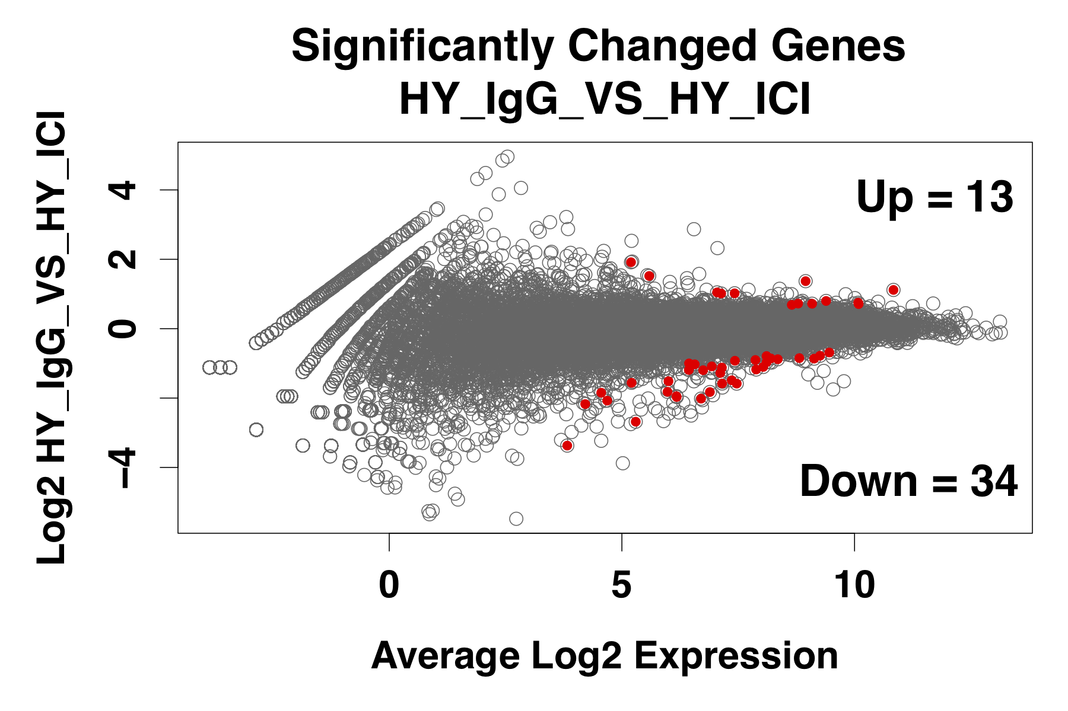
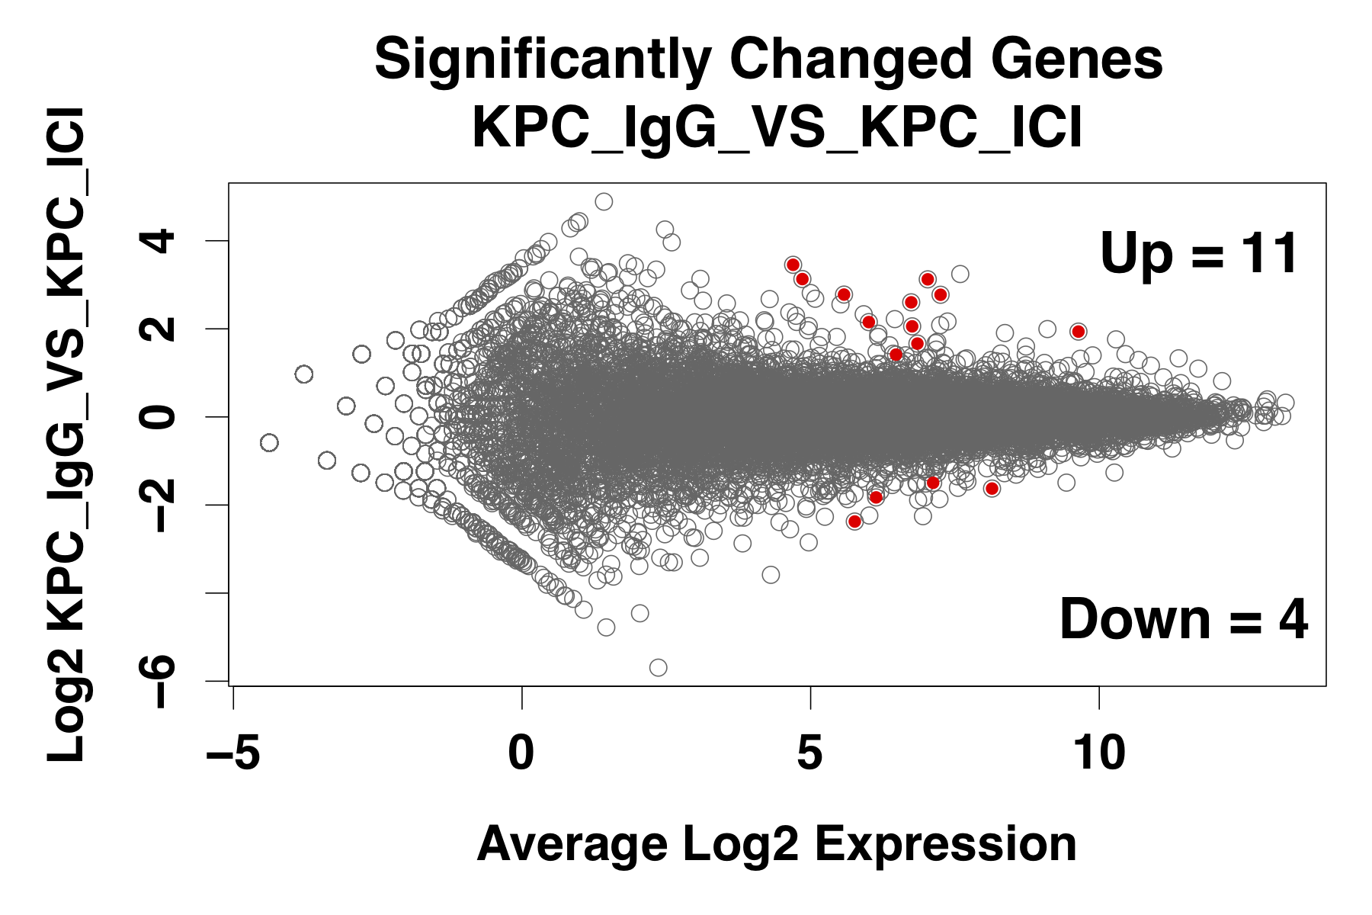
Differential gene expression analysis – ICIs vs IgG
Very few significant genes - minimal change in transcription by immunotherapy
Notes:
Significant genes aren’t solely filtered by : Log(FC) / Mean
DEseq2 outputs a ’padj’ variable which takes into account dispersions/sample variance/LogFoldChange Standard Error…
Genes are excluded if : PADJ >= .05

Slide 24
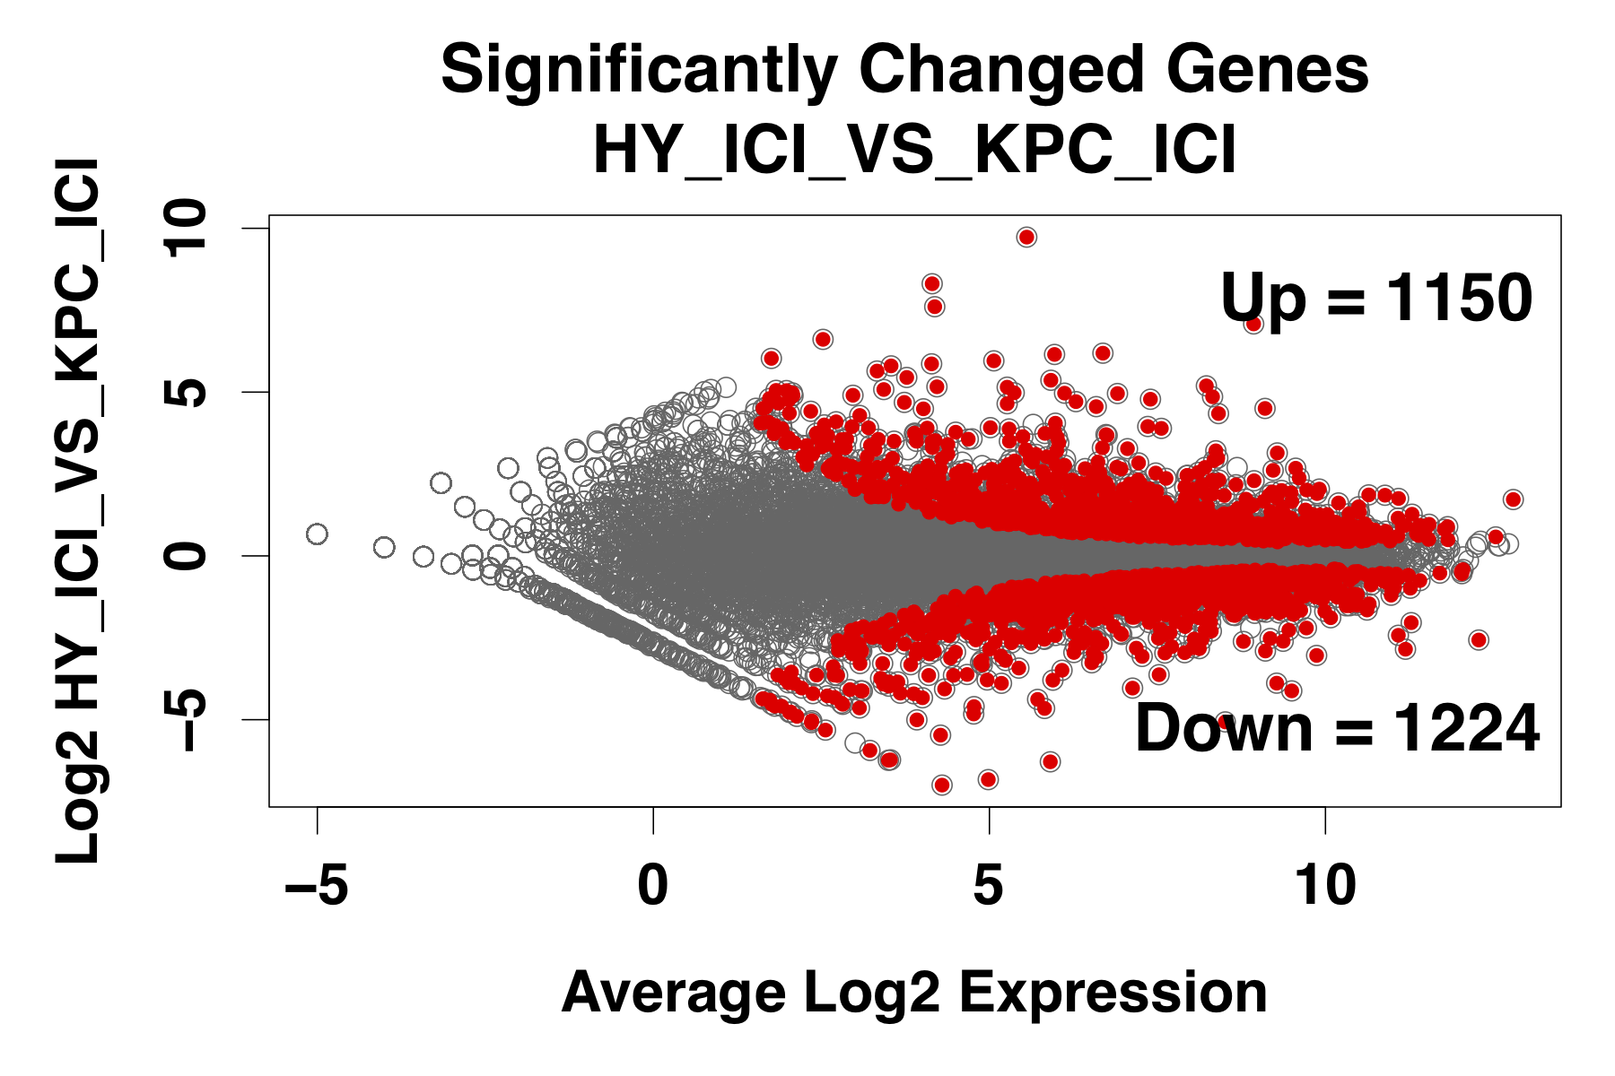
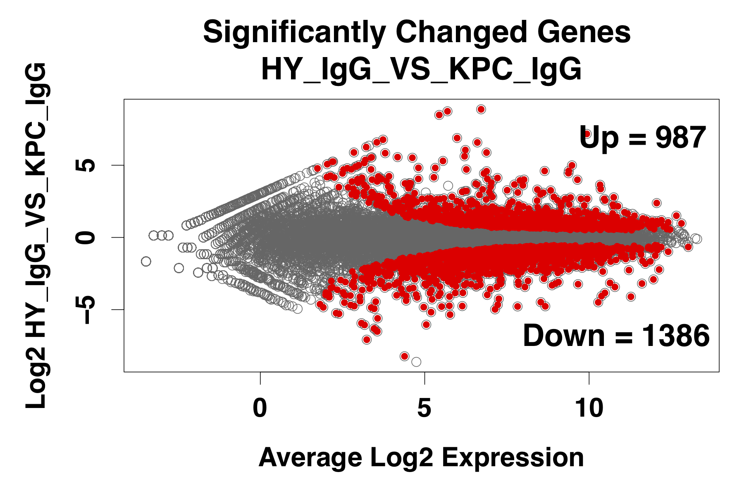
Differential gene expression analysis – p53 null vs p53 GOF
Many significant genes - massive change in transcription dependent on p53 status

Slide 25
Analysis Pipeline
PROseq *.fastq
Genome Alignment
Transcript Raw Counts
DEseq2 Normalization
preprocessing
MA-plot
Differential Statistics
Leading Edge Analysis
(GSEA)
Gene Set Enrichment Analysis
Gene Set Enrichment Analysis
GeneID | baseMean | log2FoldChange | lfcSE | padj
Gene A | 379.2 | 1.3 | 0.2 | .13
Gene B | 4992.0 | -5.1 | 4.8 | .56
Gene C | 7022.8 | -2.3 | 0.3 | .01
Gene D | 2665.1 | 0.2 | 0.3 | .93
Individual Driver Genes
Implicated Pathways
Notes:
Alignment done with bowtie+SAMtools+bigwig-storage
DEseq2 normalized with both estimateSizeFactors and single-aligned reads per millions…estimate seemed better

Slide 26
Experimental Setup
Compare cell types to find response
Untreated
IgG
Treated
ICI
3 Replicates
3 Replicates
KPC
p53 Gain of Function
HY
p53 Deletion
3 Replicates
3 Replicates

Slide 27
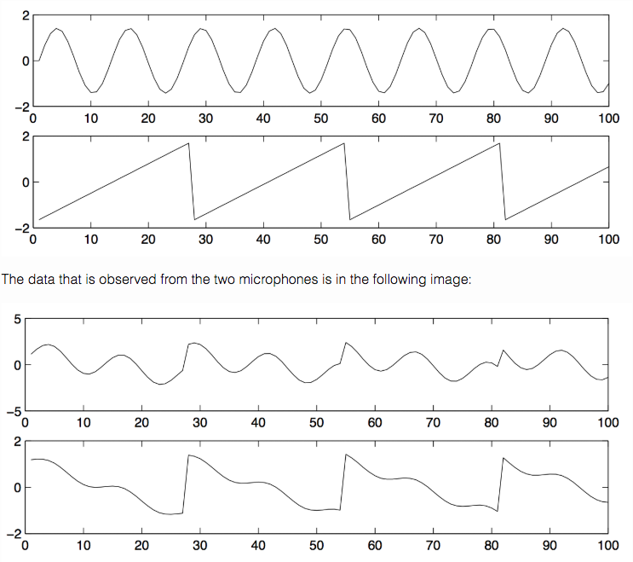
Individual component analysis
Individual component analysis (ICA):
Unsupervised machine learning method - deconvolutes non-Gaussian data into a linear combination of statistically independent components
Decomposes expression data into consistent patterns of co-expressed and coregulated genes
Historically used for blind source separation (BSS) that aims to separate source signals from their mixtures
ICA
 | S1 | S2 | S3 | S4 | S5 | S6 | S7 | S8
C1 | 8 | 9 | 0 | 6 | 1 | 3 | 5 | 6
C2 | 7 | 2 | 5 | 1 | 6 | 8 | 2 | 7
C3 | 6 | 9 | 3 | 5 | 1 | 6 | 0 | 6
C4 | 1 | 4 | 9 | 3 | 1 | 7 | 4 | 9
C5 | 8 | 9 | 0 | 6 | 1 | 3 | 5 | 6
C6 | 7 | 2 | 5 | 1 | 6 | 8 | 2 | 7
C7 | 6 | 9 | 3 | 5 | 1 | 6 | 0 | 6
C8 | 1 | 4 | 9 | 3 | 1 | 7 | 4 | 9
 | C1 | C2 | C3 | C4 | C5 | C6 | C7 | C8
g1 | 8 | 9 | 0 | 6 | 1 | 3 | 5 | 6
g2 | 7 | 2 | 5 | 1 | 6 | 8 | 2 | 7
g3 | 6 | 9 | 3 | 5 | 1 | 6 | 0 | 6
… | … | … | … | … | … | … | … | …
gn | 1 | 4 | 9 | 3 | 1 | 7 | 4 | 9
 | S1 | S2 | S3 | S4 | S5 | S6 | S7 | S8
g1 | 3 | -1 | 3 | -1 | 3 | -1 | 3 | -1
g2 | 2 | 1 | 2 | 1 | 2 | 1 | 2 | 1
g3 | -2 | -2 | -2 | -2 | -2 | -2 | -2 | -2
… | … | … | … | … | … | … | … | …
gn | 1 | 3 | 1 | 3 | 1 | 3 | 1 | 3
+
Notes:
a random vector (gene expression value) which comes from a combination of different data sources. Consider the canonical cocktail party problem. Here, we have a group of people conversing at some party.
Outperforms over PCA and clustering-based methods in obtaining a more realistic decomposition of the expression data into consistent patterns of coexpressed and coregulated genes (Lee and Batzoglou, 2003; Saidi et al. 2004; Frigyesi et al. 2006; Teschendorff et al. 2007)
ICA does not impose an orthogonality constraints between the independent components (ICs).

Slide 28
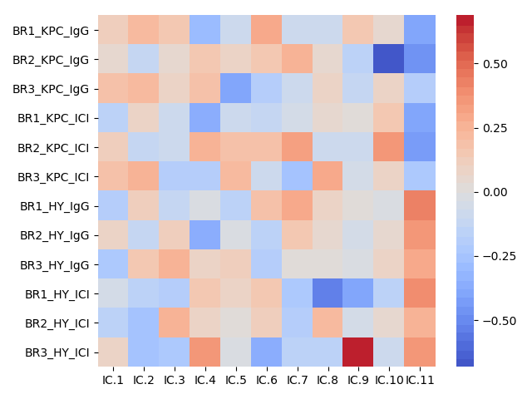
ICA signatures derived from in-vivo nascent RNA sequencing
KPC001S_tumor_IgG_BR1
KPC001S_tumor_IgG_BR2
KPC001S_tumor_IgG_BR3
KPC001S_tumor_ICI_BR1
KPC001S_tumor_ICI_BR2
KPC001S_tumor_ICI_BR3
HY19636_tumor_IgG_BR1
HY19636_tumor_IgG_BR2
HY19636_tumor_IgG_BR3
HY19636_tumor_ICI_BR1
HY19636_tumor_ICI_BR2
HY19636_tumor_ICI_BR3
.5
strength of correlation between signature and sample
0
-.5
S1
S2
S3
S4
S5
S6
S7
S8
S9
S10
S11

Slide 29
Experimental Setup
Compare cell types to find response
KPC
p53 Gain of Function
6 “Replicates”
HY
p53 Deletion
6 “Replicates”

Slide 30
Analysis Pipeline
PROseq *.fastq
Genome Alignment
Transcript Raw Counts
Independent Component Analysis
preprocessing
MA-plot
Expression
Signature
Leading Edge Analysis
(GSEA)
Gene Set Enrichment Analysis
Gene Set Enrichment Analysis
GeneID | Expression
Gene A | 379.2
Gene B | 4992.0
Gene C | 7022.8
Gene D | 2665.1
Individual Driver Genes
Implicated Pathways
Notes:
Alignment done with bowtie+SAMtools+bigwig-storage
DEseq2 normalized with both estimateSizeFactors and single-aligned reads per millions…estimate seemed better

Slide 31
Reading a GSEA-plot
Two other relevant outputs:
Normalized Enrichment Score
False Discovery Rate
estimated probability that a gene set
with a given NES represents a false positive finding
https://www.gsea-msigdb.org/gsea/doc/GSEAUserGuideTEXT.htm

Slide 32
GSEA of positive drivers of ICA signature-11 (high in KPC)
NES: 2.35
FDR q-value: 0
NES: 2.15
FDR q-value: 0
NES: 2.34
FDR q-value: 0
Notes:
IL-12:
Interleukin 12 (IL-12) is a pleiotropic cytokine, creates an interconnection between the innate and adaptive immunity.
Due to bridging the innate and adaptive immunity and potently stimulating the production of IFN-γ—a cytokine coordinating natural mechanisms of anticancer. IL-12 seemed ideal candidate for tumor immunotherapy in humans.
However, severe side effects associated with systemic administration of IL-12 in clinical investigations and the very narrow therapeutic index of this cytokine markedly tempered enthusiasm for the use of this cytokine in cancer patients.
The main source of IL-12 in humans is the activated antigen-presenting cells, such as dendritic cells, as well as the hematopoietic phagocytes (monocytes, macrophages, and also neutrophils)
While IL-12 acts on a variety of immune cells, the overall physiological role for IL-12 seems to be orchestrating the Th1-type immune response against certain pathogens.

Slide 33
GSEA of positive drivers of ICA signature-11 (high in KPC)
PSMD4:
a potent inhibitor of angiogenesis and tumor growth
activates monocytes to secrete a mixture of proinflammatory cytokines and induces them to differentiate into macrophage-like cells
up-regulates components of the NF-kB pathway
NES: 1.93
FDR q-value: 0.01
ROCK signaling:
Rho subfamily GTPases target a wide spectrum of functions, preferentially upregulation of proliferation and DNA synthesis/transcription
Rho proteins promote four main networks of interacting proteins nucleated around E2F, c-Jun, c-Myc and p53. Of those, E2F, c-Jun and c-Myc are essential for the maintenance of cell transformation. Inhibition of Rock, one of the main Rho GTPase targets, decreases c-myc gene expression without affecting the E2F and c-Jun pathways.
NES: 2.01
FDR q-value: 0
Notes:
PSMD4:
a potent inhibitor of angiogenesis and tumor growth
activates monocytes to secrete a mixture of proinflammatory cytokines and induces them to differentiate into macrophage-like cells
up-regulated components of the nuclear factor-kappaB (NF-kappaB) pathway

Slide 34
GSEA of positive drivers of ICA signature-11 (high in KPC)
Inflammatory response
Metabolism and other responses

Slide 35
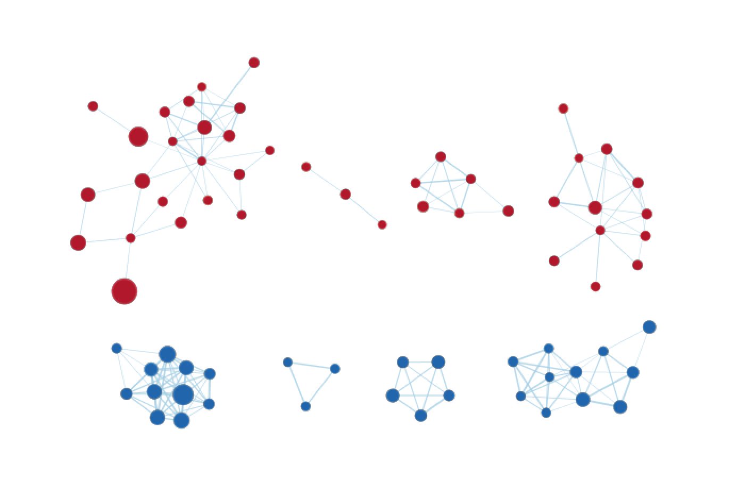
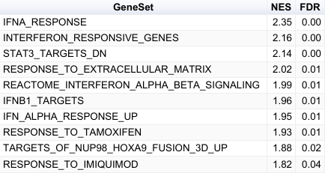
GSEA network view of ICA signature-11
Pro-inflammatory cytokine response
IL-12 pathway
Antigen presentation
Metabolism
Translation
ATP synthesis
Transcription

Slide 36
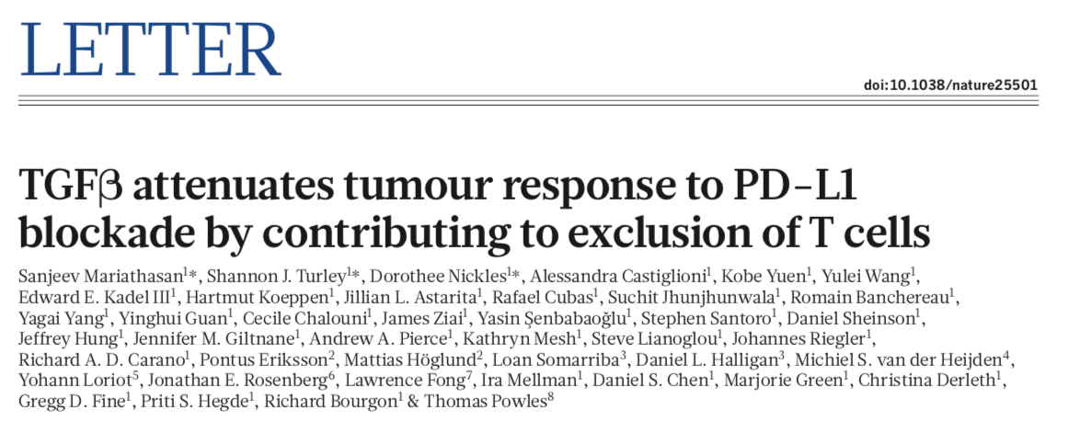
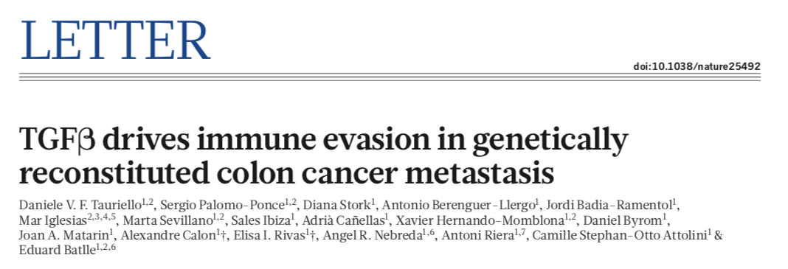
GSEA of negative drivers of ICA signature-11 (high in HY)
NES: -1.99
FDR q-value: 0.146
E.
NES: -1.91
FDR q-value: 0.141

Slide 37
Analysis Pipeline
PROseq *.fastq
Genome Alignment
Transcript Raw Counts
Independent Component Analysis
preprocessing
MA-plot
Proseq Expression
Signature
Leading Edge Analysis
(GSEA)
Gene Set Enrichment Analysis
Gene Set Enrichment Analysis
TCGA Mutation-Filtered Expression Data
Individual Driver Genes
Implicated Pathways
Leading Edge Analysis
(GSEA)
Gene Set Enrichment Analysis
Independent Component Analysis
TCGA Expression
Signature
Notes:
Alignment done with bowtie+SAMtools+bigwig-storage
DEseq2 normalized with both estimateSizeFactors and single-aligned reads per millions…estimate seemed better

Slide 38
Analysis Pipeline
TCGA Mutation-Filtered Expression Data
Individual Driver Genes
Implicated Pathways
Leading Edge Analysis
(GSEA)
Gene Set Enrichment Analysis
Independent Component Analysis
TCGA Expression
Signature
Notes:
Alignment done with bowtie+SAMtools+bigwig-storage
DEseq2 normalized with both estimateSizeFactors and single-aligned reads per millions…estimate seemed better

Slide 39
Clinical Validation using PDAC patient databases
Partition patients from TCGA and ICGC by p53 status:
GOF :
Null :
Kras^{G12D/+} / Trp53^{R172H /+}
Kras^{G12D/+} / Trp53^{- /+}
TCGA:
9 patients
11 patients
ICGC:
10 patients
15 patients

Slide 40
Clinical Validation using PDAC patient databases
Partition patients from TCGA and ICGC by p53 status:
GOF :
Null :
Kras^{G12D/+} / Trp53^{R172H /+}
Kras^{G12D/+} / Trp53^{- /+}
TCGA:
9 patients
11 patients
ICGC:
10 patients
15 patients
Incomparable RNA Expression data

Slide 41
Experimental Setup
Compare patient types to find response
p53 Gain of Function
9 “Replicates”
p53 Deletion
11 “Replicates”

Slide 42
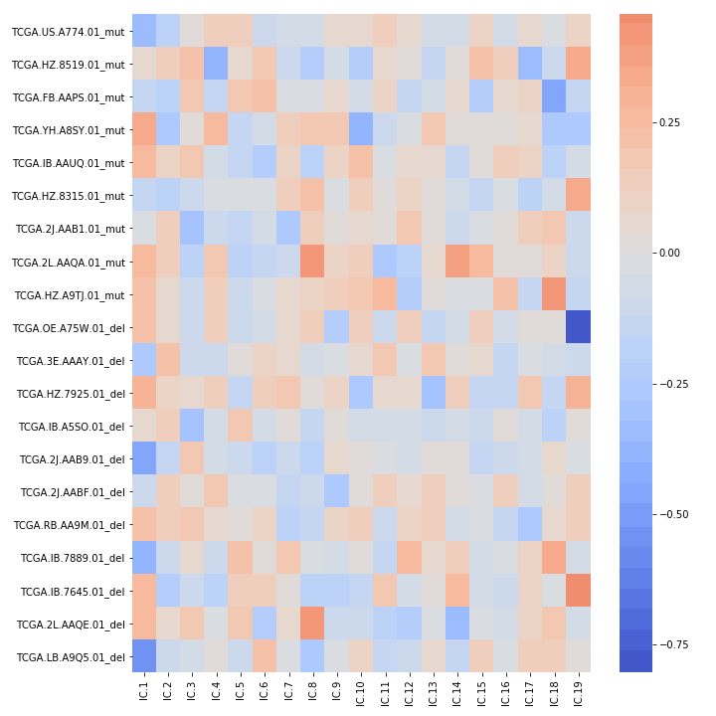
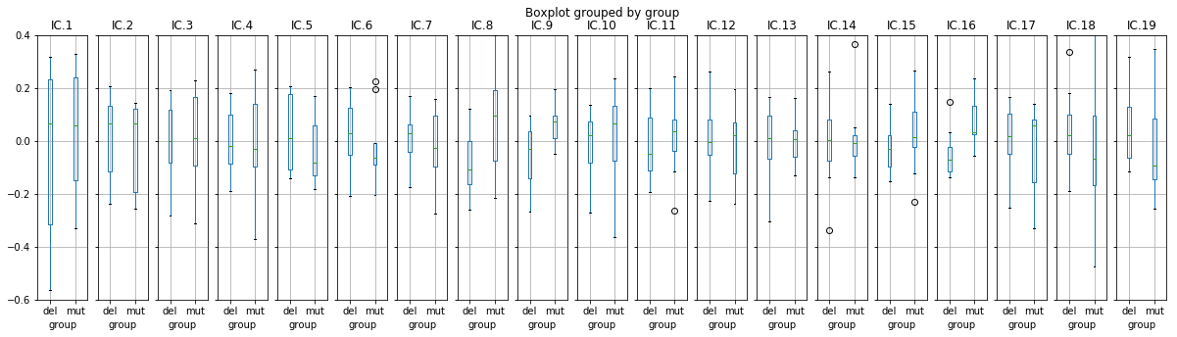
ICA - in-vivo signature-11 validation with TCGA signature-16
*

Slide 43
ICA - in-vivo signature-11 validation with TCGA signature-16
*
*

Slide 44
Presentation Outline
Problem
Experimental Setup
Analysis Pipeline
Findings
Future Research

Slide 45
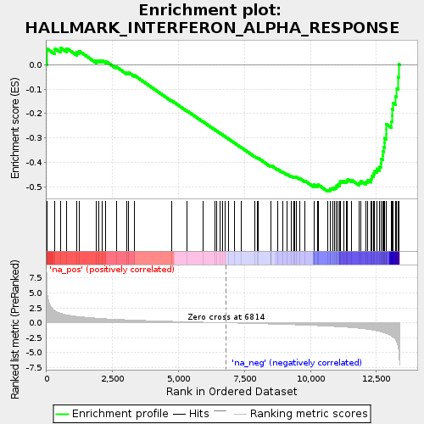
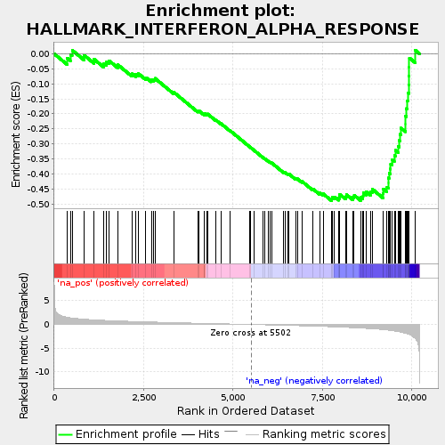
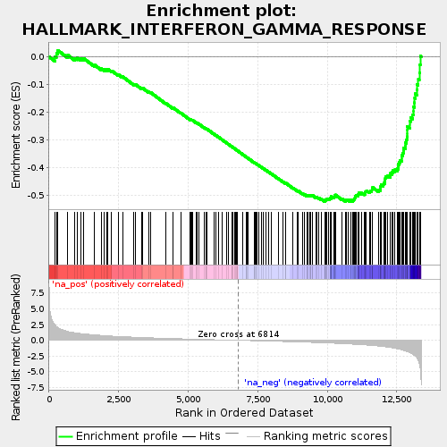
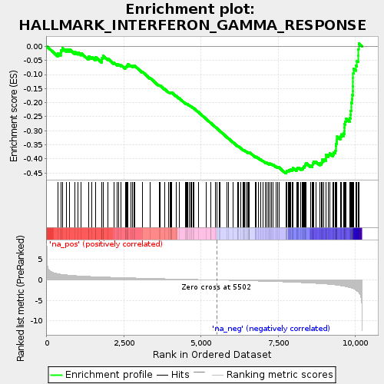
GSEA (Hallmarks set) in ICA signature-11 (in-vivo) and TCGA
PDAC pre-clinical
TCGA patient samples
NES: -1.87
FDR q-value: 0.00
NES: -1.84
FDR q-value: 0.00
NES: -2.10
FDR q-value: 0.00
NES: -1.88
FDR q-value: 0.00

Slide 46
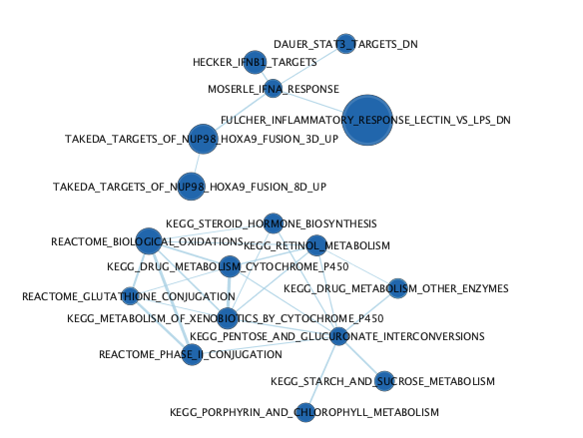
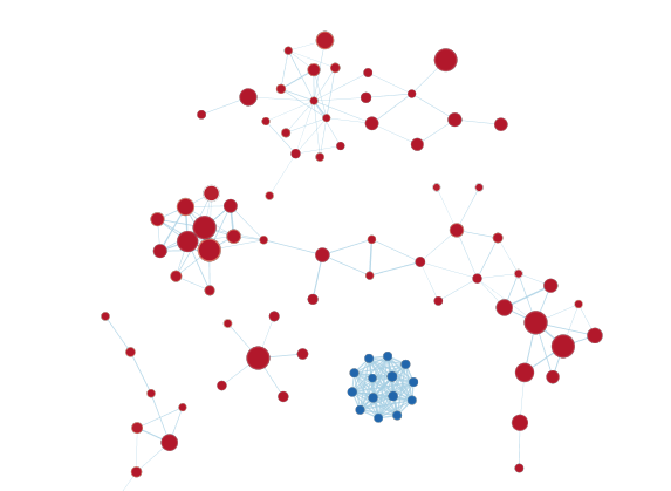
GSEA Networks in ICA signature-11 (in-vivo) and TCGA
PDAC pre-clinical
TCGA patient samples
Inflammatory Response
Inflammatory Response

Slide 47
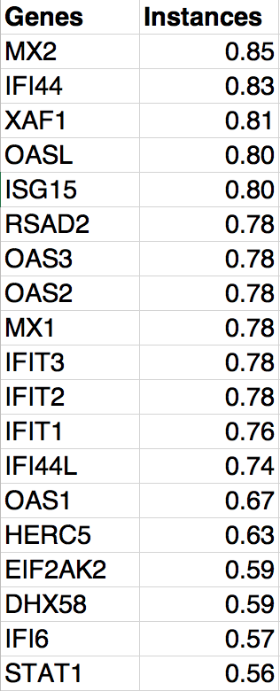
Leading-edge analysis of driver genes in signatures associated with pre-clinical PDAC model & patient samples

Slide 48
Significant overlap in signature genes derived from PDAC mouse model and patient samples with p53 GOF
PDAC pre-clinical
TCGA patient samples
Representation in GSEA (%)
Representation in GSEA (%)
1
100
Ranking
100
1

Slide 49
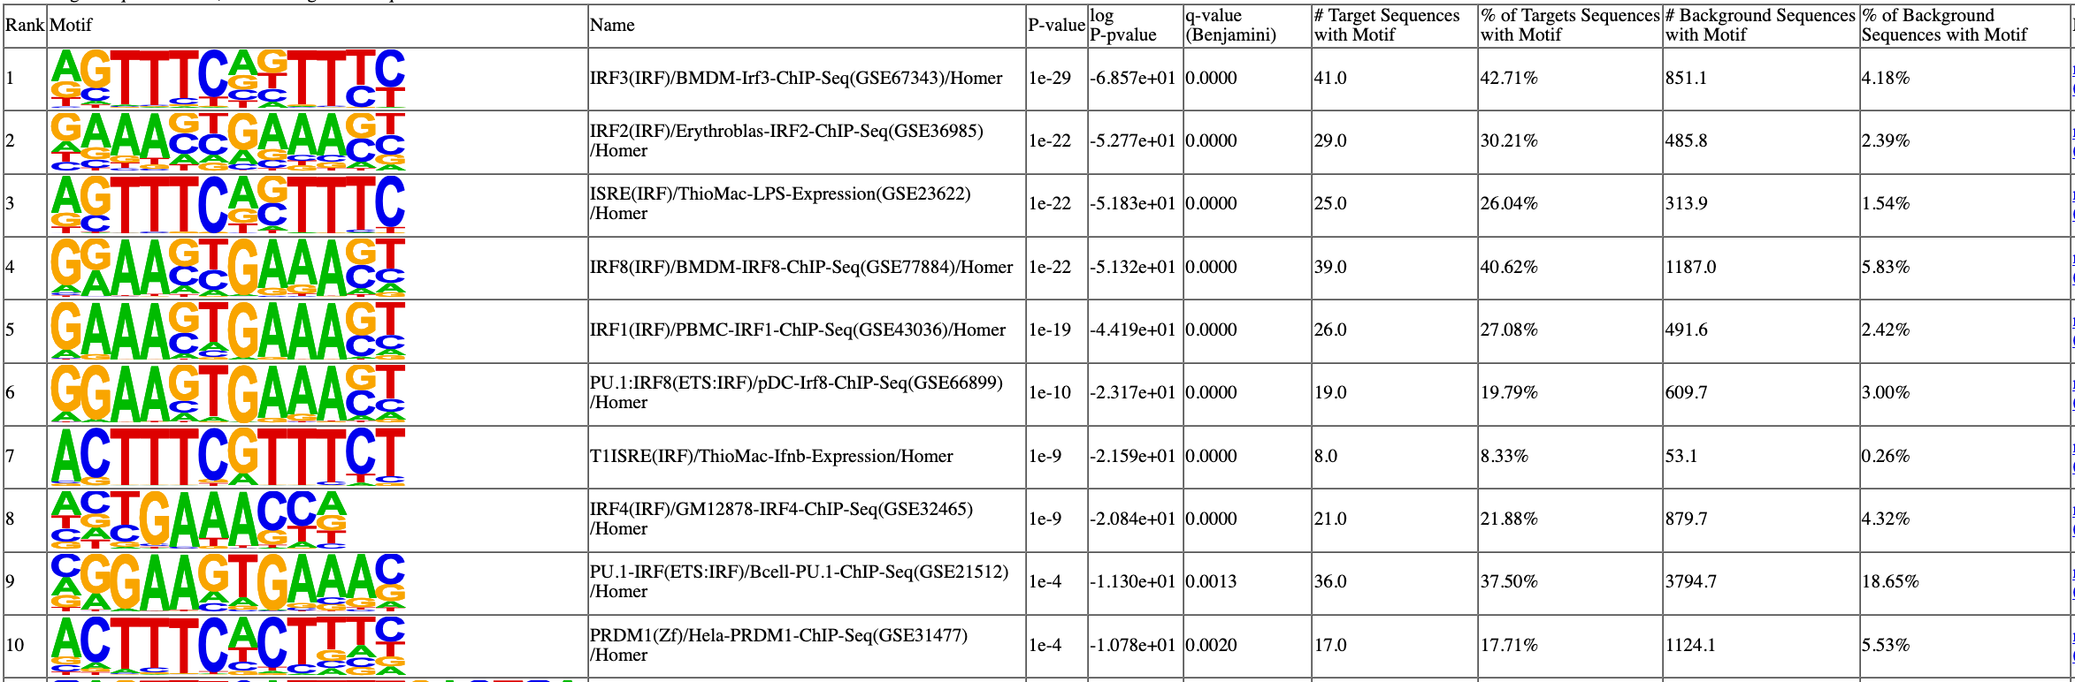
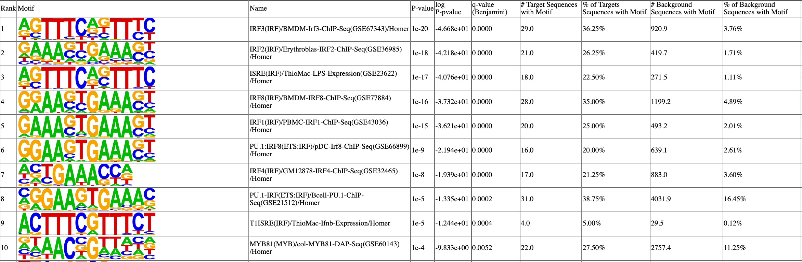
Significant overlap in signature genes derived from PDAC mouse model and patient samples with p53 GOF
PDAC pre-clinical
TCGA patient samples

Slide 50
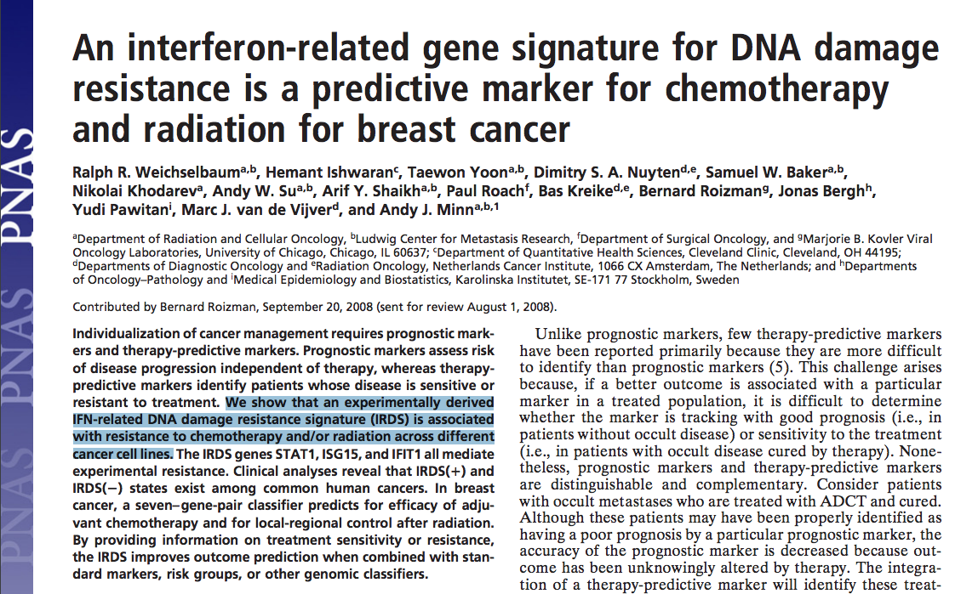
IFN-related DNA damage resistance signature (IRDS)
Overlapping gene signature between PDAC pre-clinical model & TCGA patient samples resembles IRDS

Slide 51
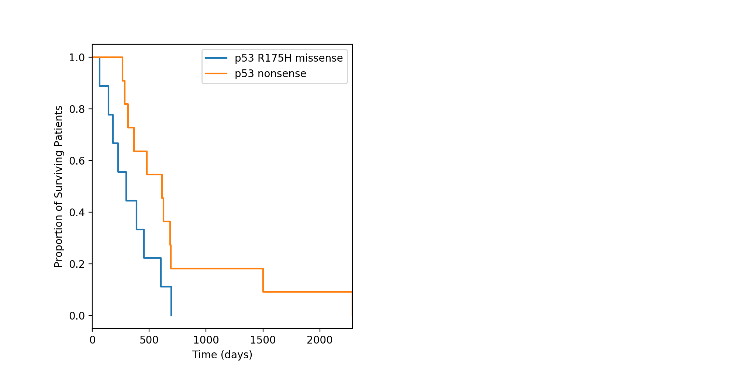
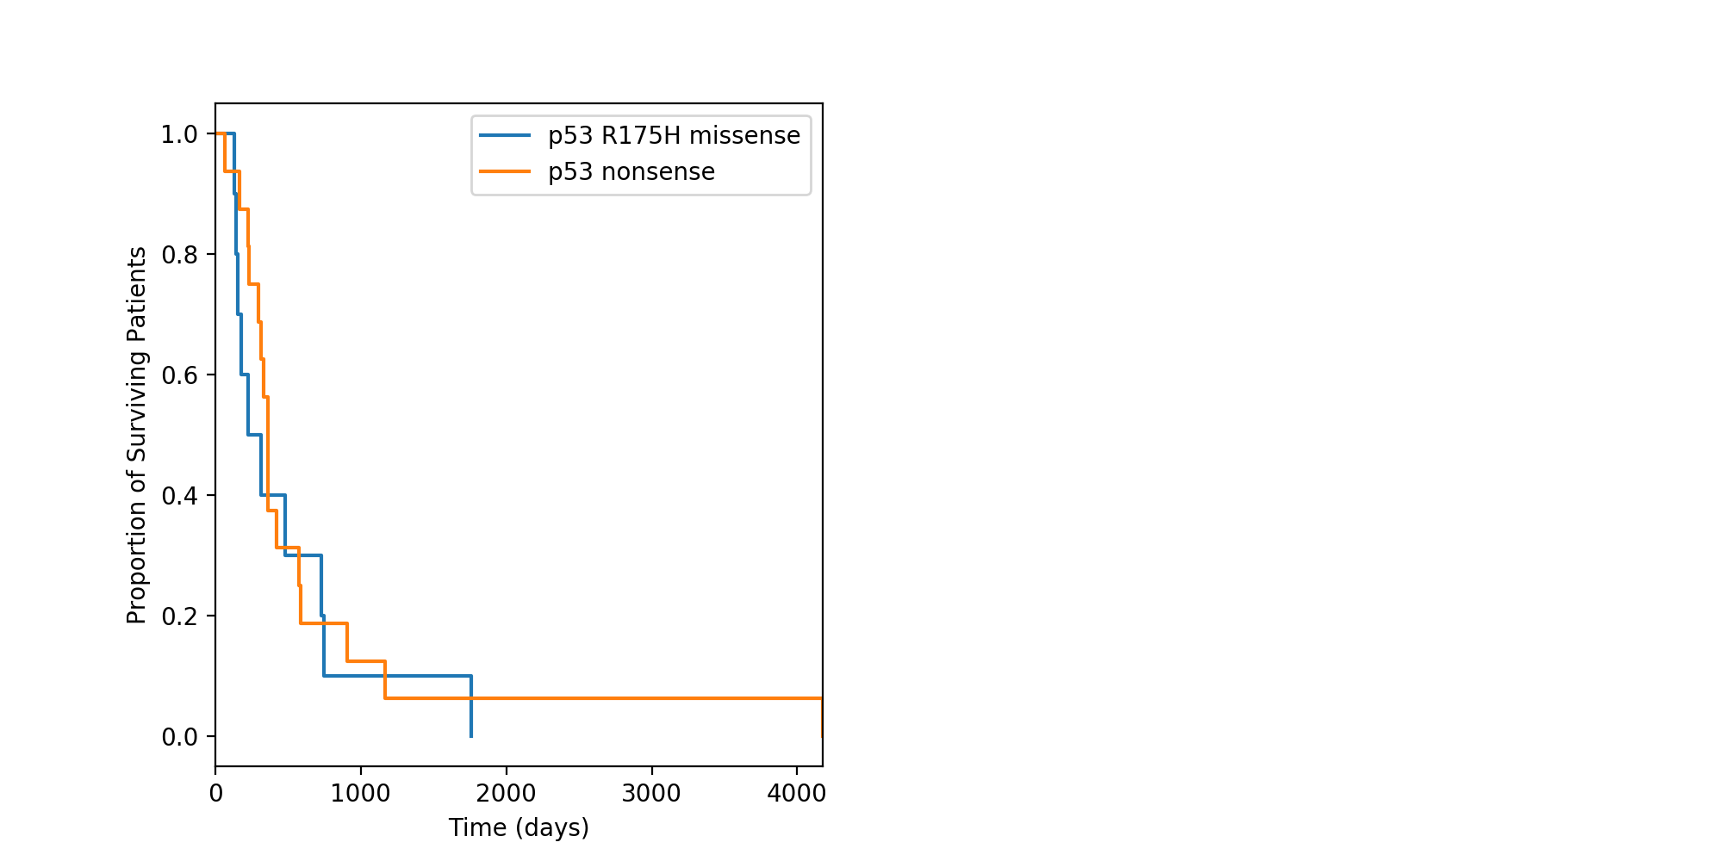
Survival of p53 GOF patients vs p53 null patients
TCGA
ICGC
GOF
Null
GOF
Null
p = 0.207
p = 0.502
Resistance of IRDS to radiation and chemotherapy → poor prognosis?

Slide 52
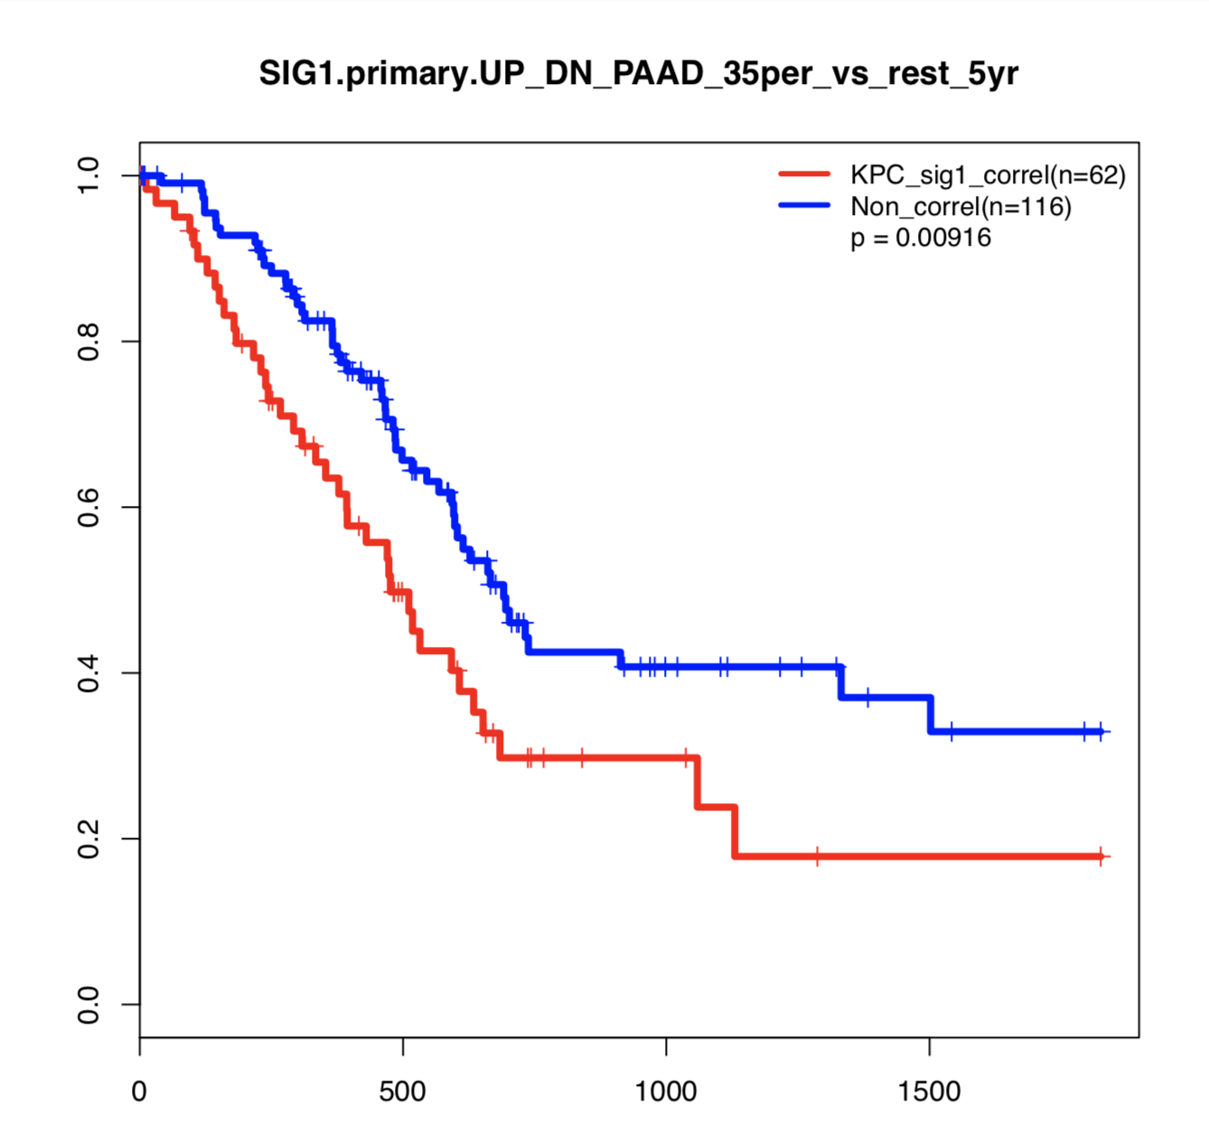
Survival of PDAC patients with ICI-responsive (KPC)-like gene expression
Stratified patients based on gene expression correlation to ICI-responsive PDAC models (KPC)
Divided into two cohorts:
Top 35% vs Remaining 65%
Top 35% (n=62)
Remaining 65% (n=116)
Fraction of patients alive
Survival (Days)
Notes:
Excluded analysis

Slide 53
Selective response of in vivo murine models of PDACs to immune checkpoint inhibitors (ICIs)
p53 status
GOF (mutation) vs. LOF (deletion)
(KPC001S) (HY19636)
Immunotherapy
Responsive vs. unresponsive
(KPC001S) (HY19636)
Type-I Interferon signaling
high vs. low
(KPC001S) (HY19636)
Cytokine response
Pro-inflammatory vs. anti-inflammatory
(KPC001S) (HY19636)
Tumor infiltrated CD8⁺ T-cells
Pro-inflammatory vs. anti-inflammatory
(KPC001S) (HY19636)
CD8⁺ T-cells tumor infiltration
Infiltrated vs. excluded
(KPC001S) (HY19636)

Slide 54
Presentation Outline
Problem
Experimental Setup
Analysis Pipeline
Findings
Future Research

Slide 55
Work in progress:
More biological replicates
Comb through FACSed Cancer, CAFs, and CD4⁺ cells
Use in-vitro data to decipher the differential roles of p53 status
Understand the tumor microenvironment reprogramming by GOF p53
Identify transcription factors driving the signatures
Examine the role of enhancers and super-enhancers in regulation of signature genes

Slide 56
Future experiments:
Functional:
Validate immunotherapy responsiveness with additional cell lines / mouse models
Substitute p53 null with R^{172H} & vice versa
Inflammatory response (Cytokines, Chemokines)
INF signatures
Immune-cell infiltration
Mechanistic:
P53 R^{172H} antibody for ChIP-seq (new target of p53 GOF)
P53 R^{172H} antibody for co-IP (new binding partners of p53 GOF)

